Slide 1

Report Analytics & Dashboard
Presented By - Group 3
Mentor- Mahindra Singh
Group Members are as fallows-
Ms. Aditi Digambar Bhumbar
Mr. Pratik Anil Uttekar
Ms. Hafsa Mohammadi
Mr. Pottonuru Shiva
Ms. Srushti Ravindra Patil
Ms. Swathi . V

Slide 2
Project Overview :
Name of the Project – Supply Chain Dashboard
Dashboards created by using –
Excel
Tableau
Power BI

Slide 3
KPI’S of the Project:
Total Sales(MTD,QTD,YTD)
Product Wise Sales
Sales Growth
Daily Sales Trend
State Wise Sales
Top 5 Store Wise Sales
Region Wise Sales
Total Inventory
Inventory Value
Over stock, Out Stock , Under stock

Slide 4
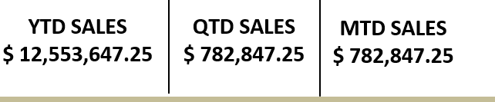
KPI Details :
1.Total Sales (MTD, QTD, YTD):
MTD (Month-to-date) refers to the total sales value recorded
within the current month.
QTD (Quarter-to-date) represents the total sales value
recorded within the current quarter
YTD (Year-to-date) refers to the total sales value recorded within the current year.

Slide 5
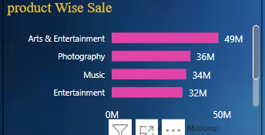
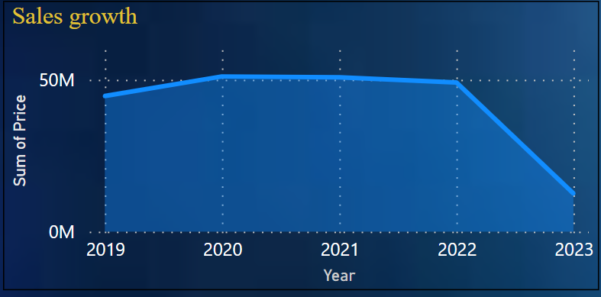
2.Product Wise Sales:
This refers to the sales figures for each individual product in the supply chain data set. It provides information on the sales performance of each product separately.
3. Sales Growth:
Sales growth measures the rate at which sales have increased or decreased over a specific period. It can be calculated by comparing sales figures from different time periods, such as comparing current sales with previous month’s or year's sales.

Slide 6
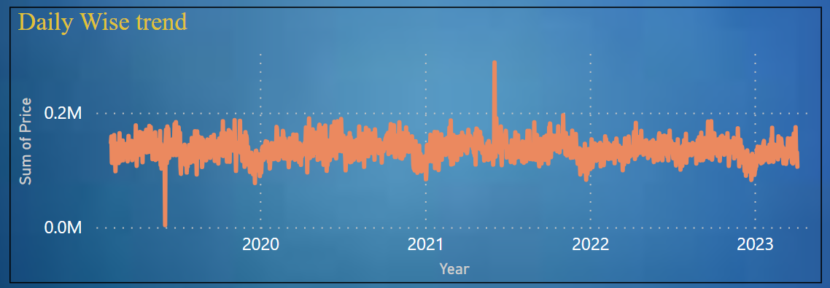
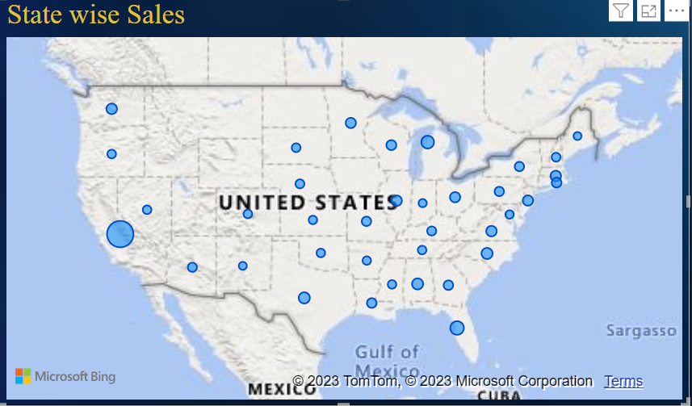
4.Daily Sales Trend:
Daily sales trend shows the pattern or trend in sales over a period of days. It helps identify any fluctuations or patterns in sales on a daily basis, which can be useful for demand forecasting and planning.
5.State Wise Sales:
State wise sales refer to the total sales value attributed to each state or region within a country. It provides insights into the sales performance in different geographical areas.

Slide 7
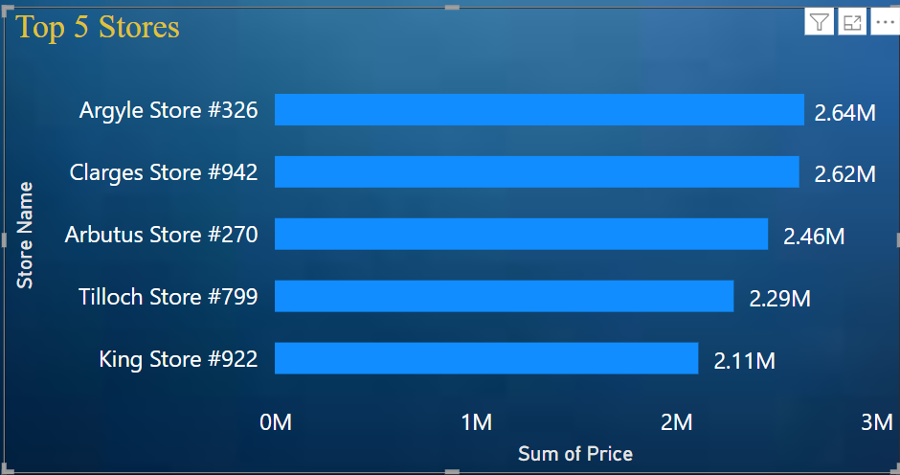
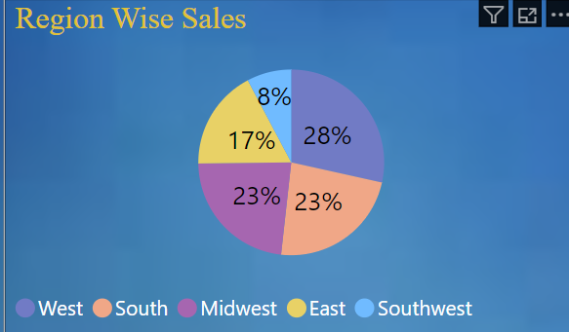
6.Top 5 Store Wise Sales:
This refers to the top 5 stores or retail outlets that have achieved the highest sales figures. It helps identify the most successful stores or locations within the supply chain.
7.Region Wise Sales:
Region wise sales refer to the total sales value attributed to each specific region or area within a larger geographic scope, such as a country or continent. It provides insights into the sales performance across different regions.

Slide 8

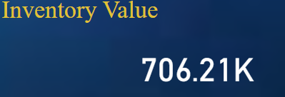
8.Total Inventory:
Total inventory represents the sum of all the goods or products held in stock within the supply chain. It includes both finished products ready for sale and raw materials or components used in the production process.
9.Inventory Value:
Inventory value refers to the total monetary value of the inventory held within the supply chain. It is calculated by multiplying the quantity of each item in inventory by its unit cost or market value.

Slide 9
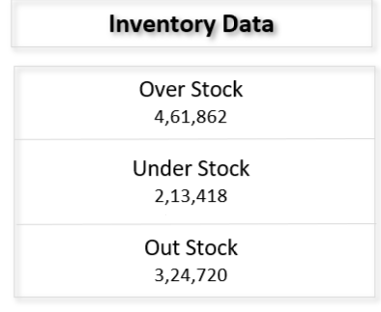
10. Overstock, Out of Stock, Understock:
Overstock occurs when the supply chain has excess inventory beyond the demand, leading to a surplus.
Out of stock refers to the situation when the supply chain does not have enough inventory to meet the current demand.
Understock refers to a situation where the inventory level is lower than the desired or optimal level for meeting demand.

Slide 10
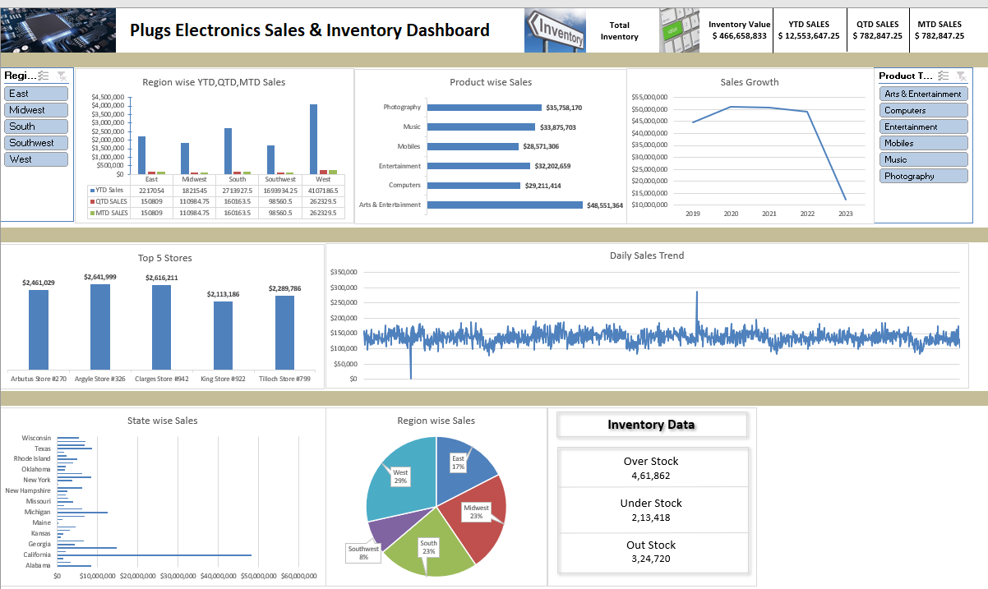
Dashboard 1 : Excel

Slide 11
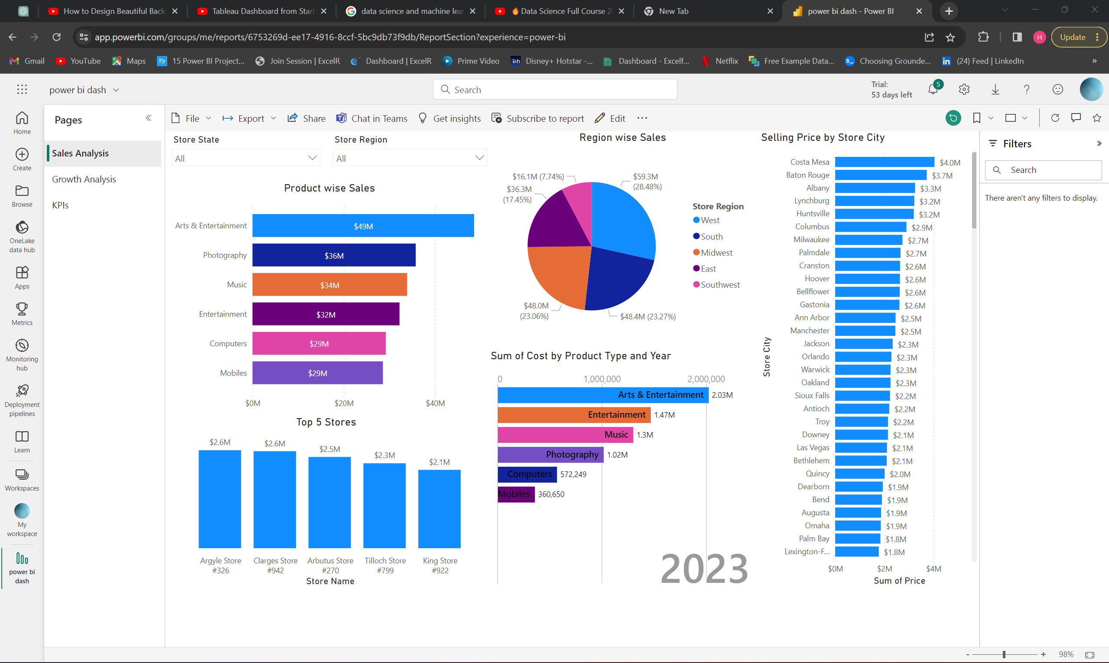
Dashboard 2 : Tableau

Slide 12
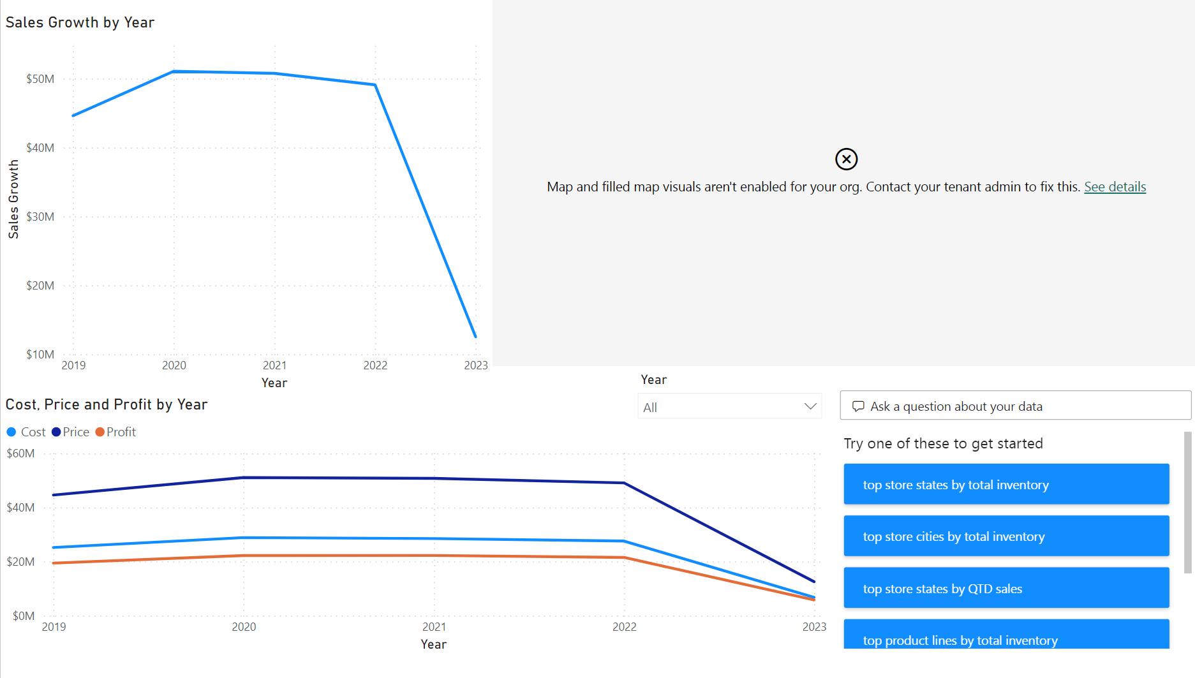

Slide 13
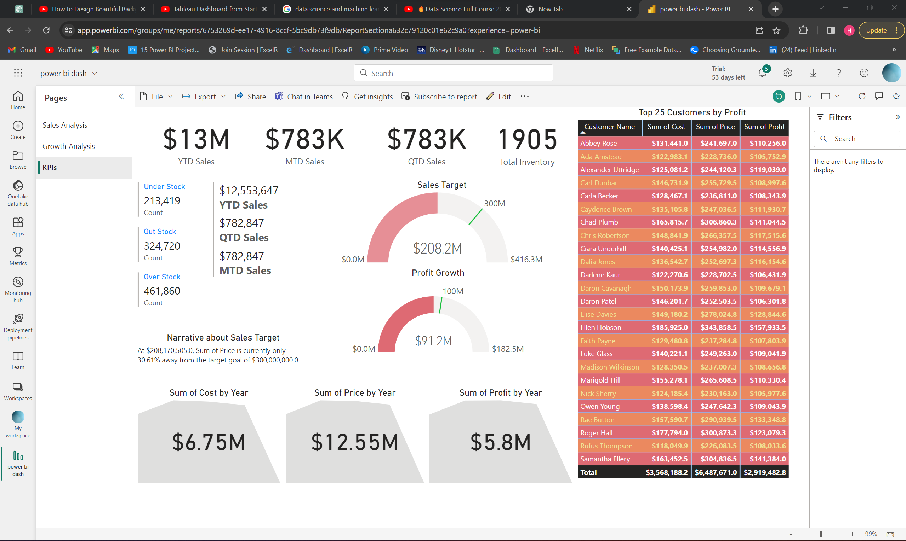

Slide 14
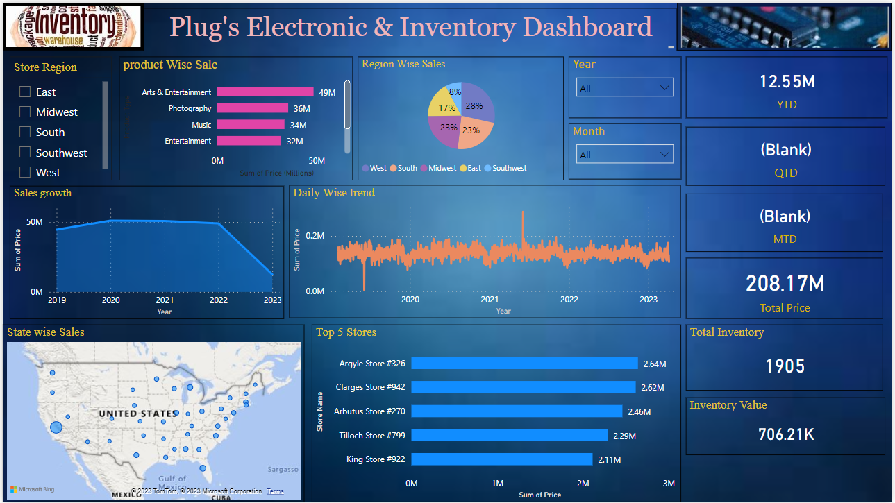
Dashboard 3: Power BI

Slide 15
Thank you

